Slide 1
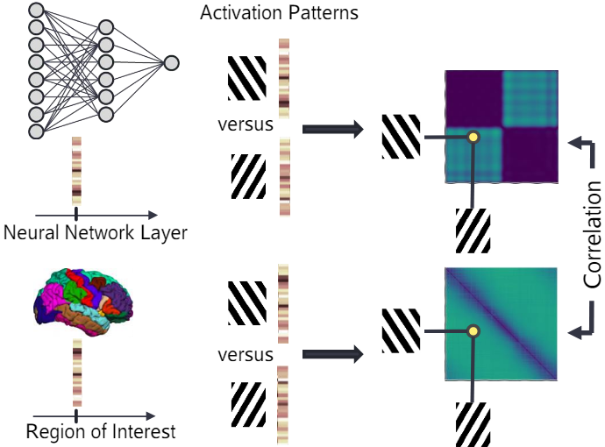

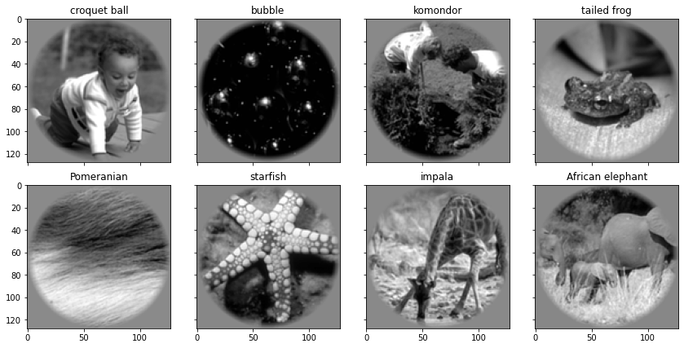
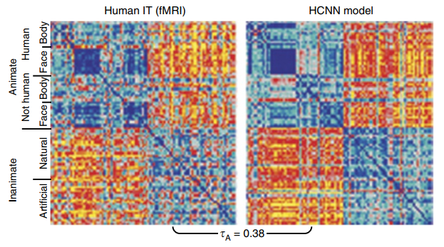
How to understand the complex response pattern in high-level brain areas?
Background:
Neurons in high-level brain areas show complex responses pattern (Rigotti et al, 2013), which can’t be decoded by a linear combinations of Gabor filters like early visual areas (Kay et al. 2008).
Methods: [top right]
Map these spatial activity patterns to representational geometry (Kriegeskorte & Diedrichsen, 2019) to characterize these complex pattern by representation similarity analysis .
Compare neural network and brain to see how these stimuli are encoded respectively.
Dataset: Kay/Gallant [middle right]
Subjects passively watch the stimuli in fMRI scanner.
We labeled the stimuli into 4 categories by hand: animate-animals, animate-human, inanimate-artificial, inanimate-natural (Khaligh-Razavi & Kriegeskorte 2014).
We assume all stimuli in the same category elicit a prototypical response pattern, which implies small dissimilarities between within-category representations.
Hypothesis: [bottom right] (extracted from Yamins & DiCarlo, 2016)
The representations of stimuli are gradually decoupled from low layers to high layers.
The representations cluster into 4 categories (show small distance in representational geometry) in high layers of the brain and neural network, but not in low layers.

Slide 2
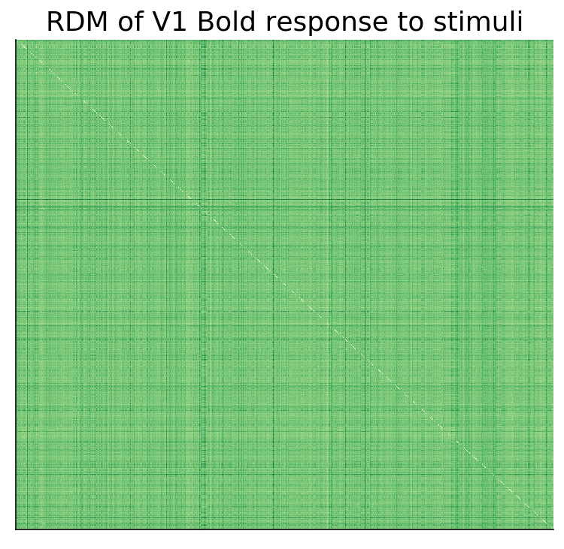
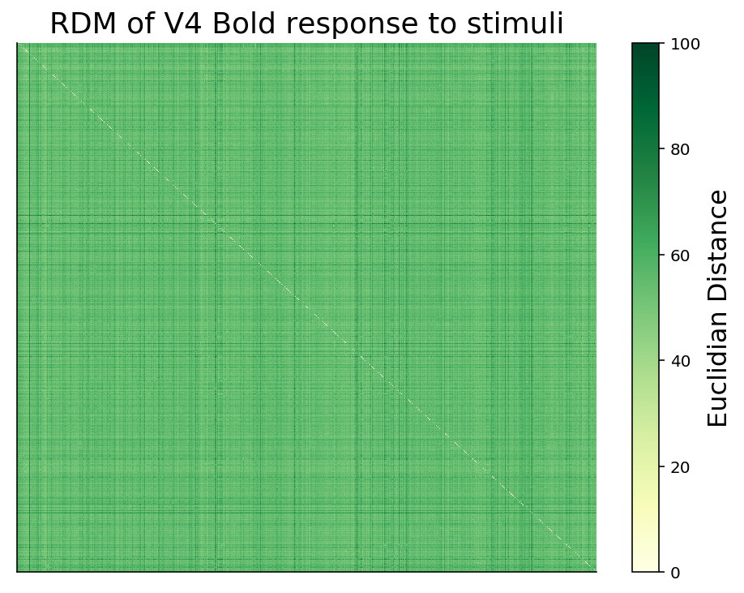
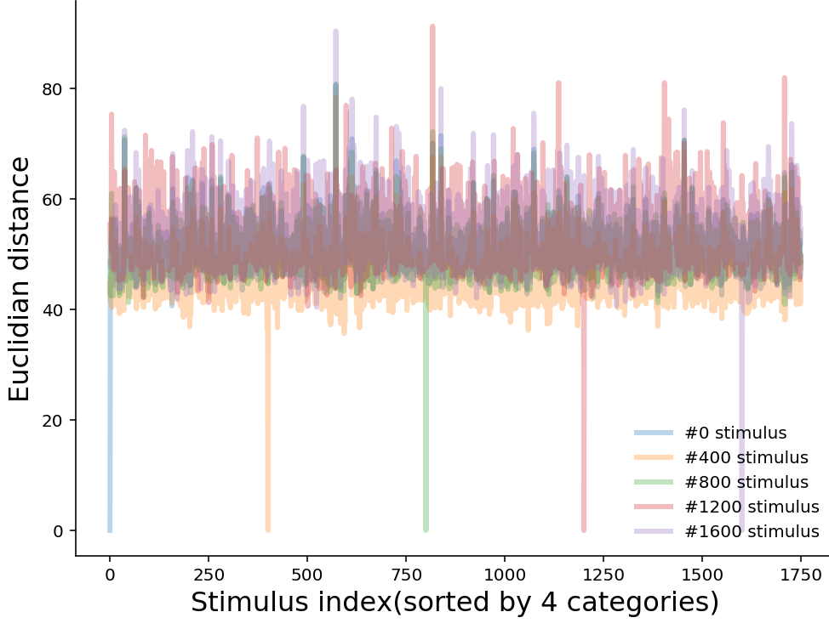
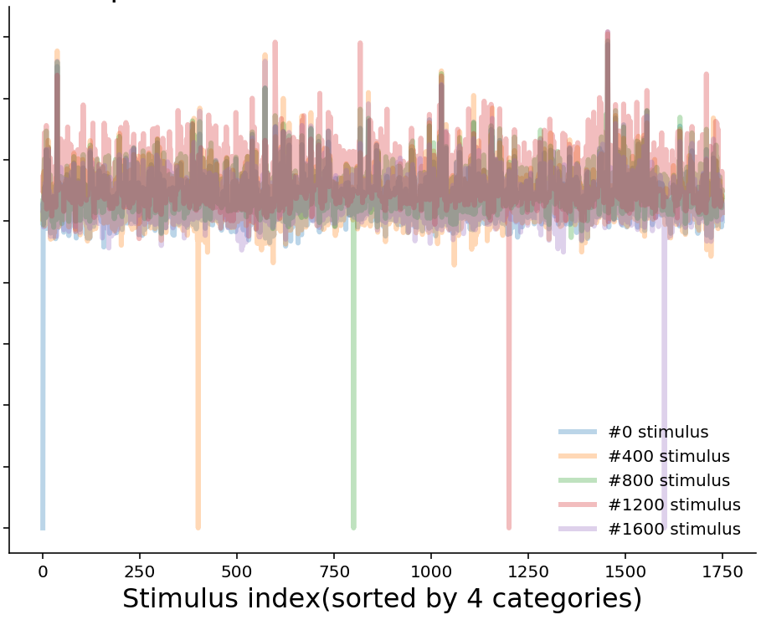
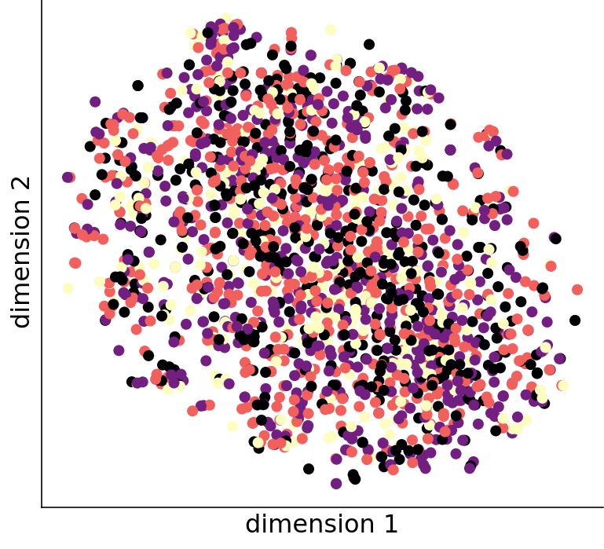
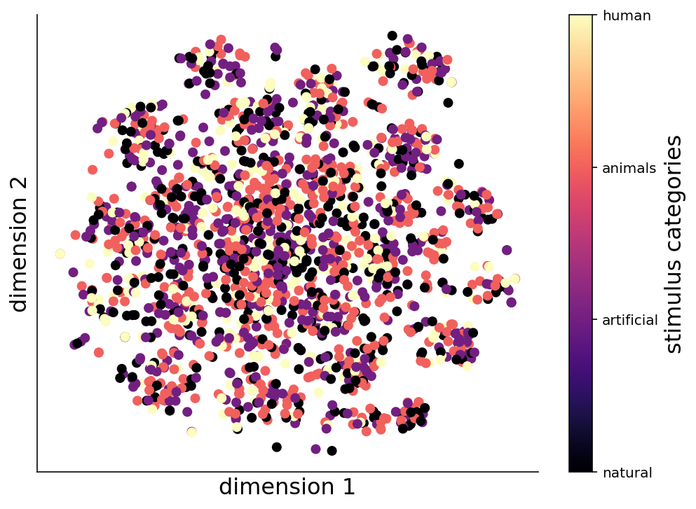
Compute representational dissimilarity matrix in brain
natural
inanimate
artificial
animals
Interpret representational geometry (Kriegeskorte & Diedrichsen 2019)
Euclidean distance precisely defines the discriminability of a pair of stimuli.
Linear: this is a biologically plausible computation for a single neuron, the information a downstream neuron might extract from a neural population.
Nonlinear: the information in this brain area (even can’t decoded by brain).
Representational geometry reflects how differently the stimuli are encoded.
Representation dissimilarity matrix of the fMRI data
A stimuli(1750) x stimuli(1750) matrix, stimuli are sorted by 4 categories.
The stimuli have an almost equally long distance from each other[top&middle right], suggesting the encoding is high-dimensional.
The result seems plausible in V1: brain doesn’t cluster the stimuli by their semantics in early visual cortex. But there should be some clusters in V4.
Why?
We don’t have data in high-level brain areas, where the result may be different.
Stimuli are unclear and hard to identify, thus the process may be purely perceptual. Subjects couldn't use smooth coding scheme to encode.
The spatial activity of fMRI evoked by the stimuli in early visual cortex can’t be clustered by non-linear unsupervised method[bottom right].
animate
human
natural
artificial
animals
human
natural
artificial
animals
human
Distance of fMRI responses between one stimulus and all other stimuli in V1(left) and V4(right)
Low dimensional responses reduced by t-SNE in V1(left) and V4(right)

Slide 3
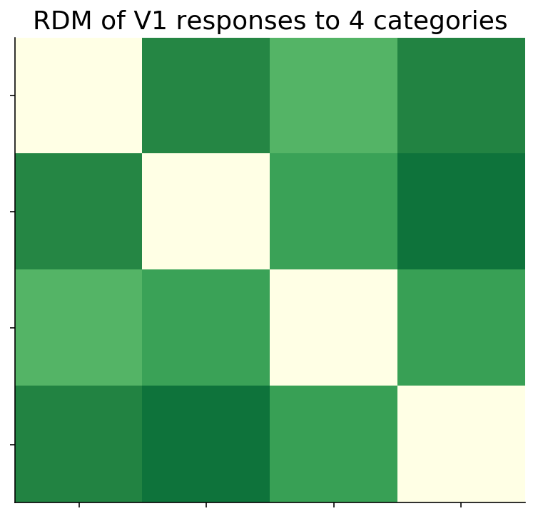
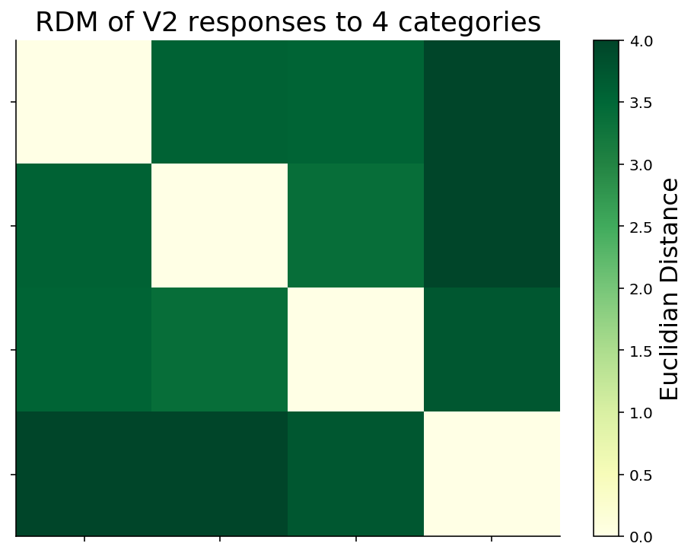
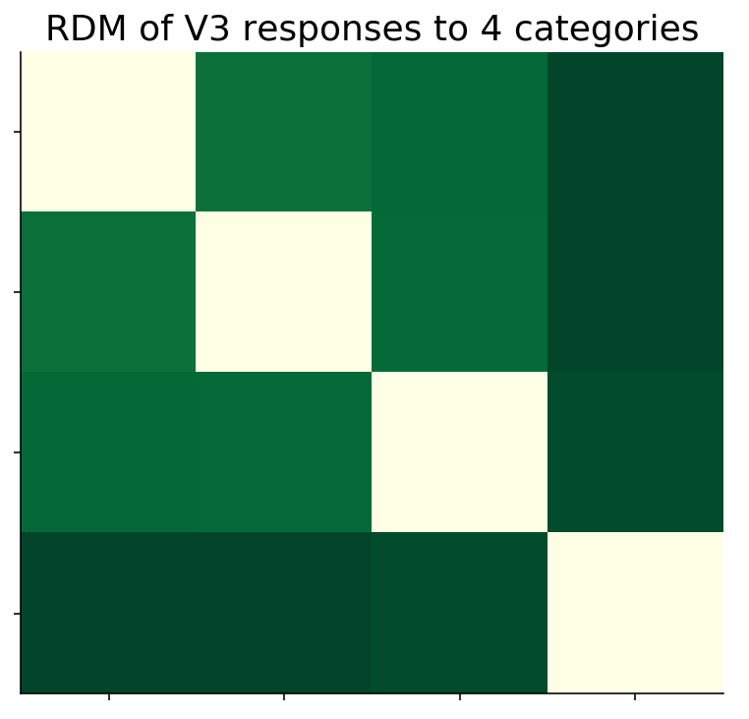
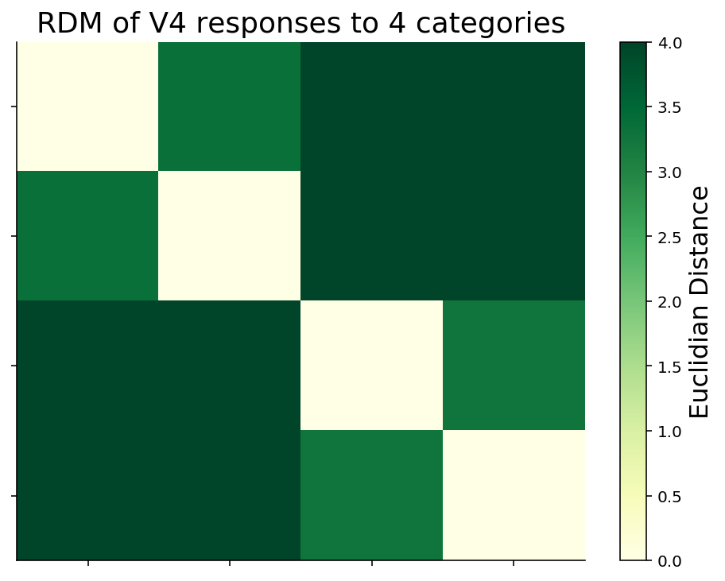
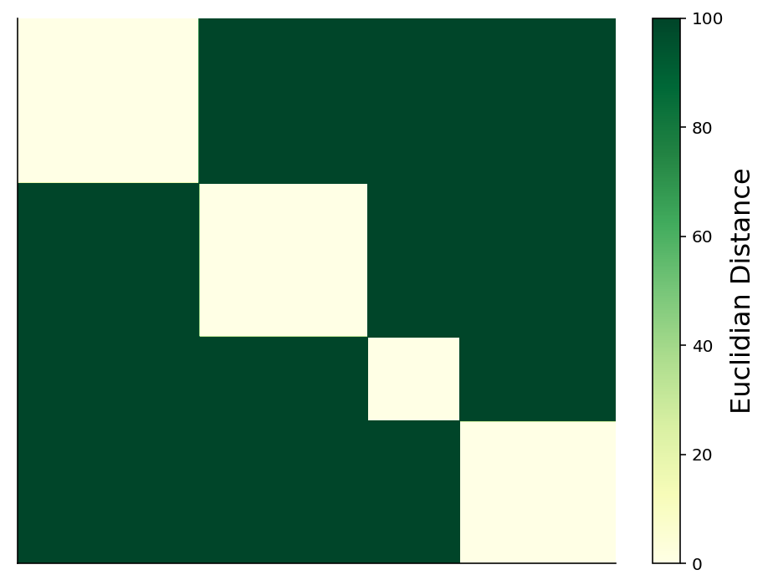
Compare neural network and brain in representational level
natural
inanimate
artificial
animals
RDM of the fMRI responses after de-noise by averaging
fMRI data may be too noisy, so we average across stimuli within each categories and get a categories(4) x categories(4) matrix[top&middle right].
The distances between categories become longer from V1 to V4, implying that the representations of categories are gradually decoupled.
The distances within the two broad categories, i.e. “animate” and “inanimate”, gradually become shorter and cluster together from V1 to V4. This may imply the stimuli in the same semantic category elicit a prototypical response pattern, which is what we expect.
animate
human
natural
artificial
animals
human
natural
artificial
animals
human
natural
inanimate
artificial
animals
animate
human
Neural network on this task
Use a pretrained Resnet-18 (He et al. 2016), a brain-like recurrent ANNs CORnet (Kubilius et al. 2018), a self-implement RCNN with biologically-plausible lateral and top-down connections (Spoerer et al. 2017).
Resnet-18 achieve 78% top-1 accuracy on test set, the accuracy of the other two models are chance-level. Thus we only compare the hidden activity between Resnet and brain in representational level.
Every layers of Resnet have the exactly same RDM, and the stimuli(1750) precisely clustered into these 4 categories [bottom right].
This may imply only 1 convolutional layer is enough to classify all stimuli. But with convolutional layers, only Resnet do this transfer learning task successfully.
natural
artificial
animals
human
natural
artificial
animals
human
(Different size of the square is due to each category has different number of stimuli)
RDM of all layers in Resnet
natural
inanimate
artificial
animals
animate
human
natural
artificial
animals
human

